Slide 1
Ellipse Detection
Michael Scheinfeild

Slide 2
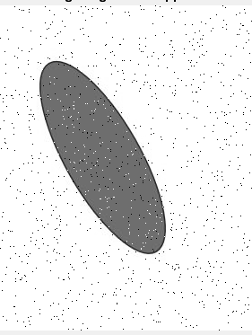
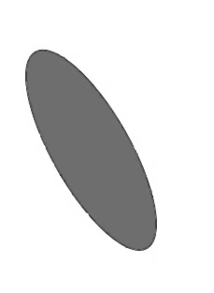
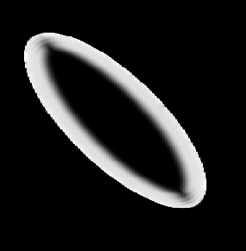
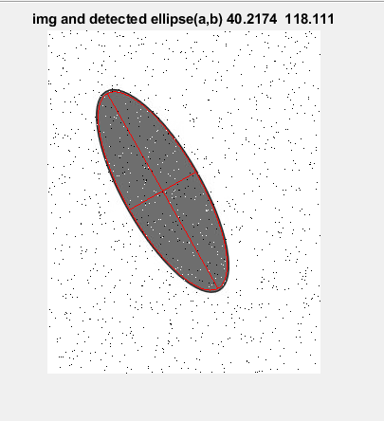
1 Ellipse
FrangiFilter
Median
Filter
Noisy image
Cleaned image
threshold
X,y
fit
Least Squares

Slide 3
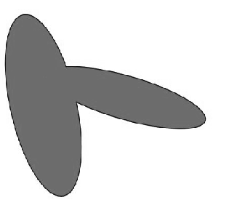

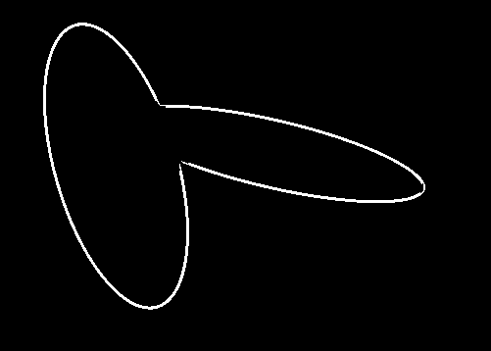
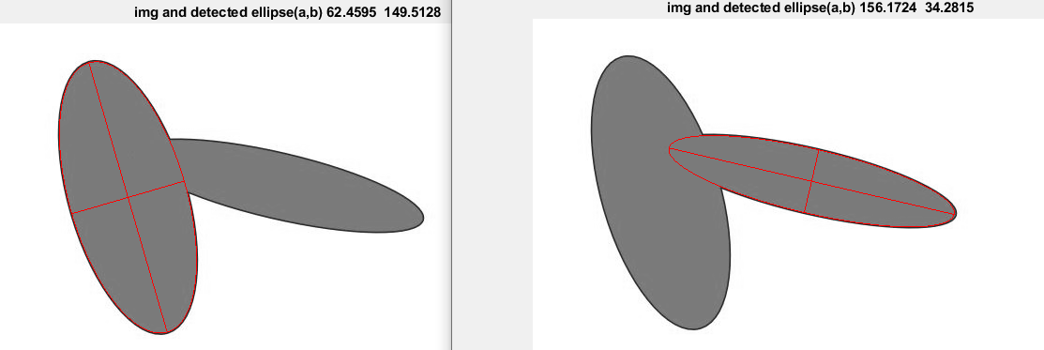
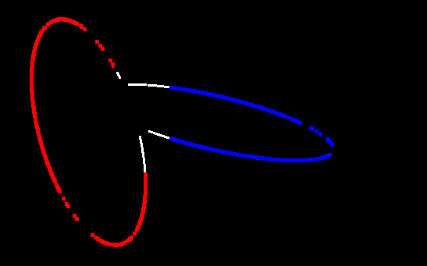
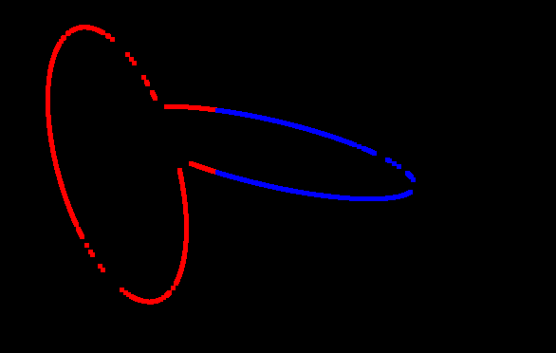
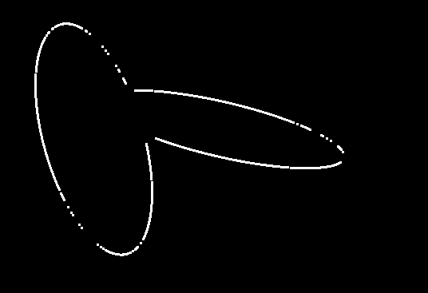
2 ellipse detection
image
FrangiFilter
Threshold
Open morphology
Cluster
Clean
x,y
Kmeans
K=2
1. majority cluster
2. Near cluster minority

Slide 4
Additional methods tested
Hough (from file exchange) works good on 1 elipse
Watershad as matlab example separate circles , seems need more effort of thresholding/ morphology to separate elipses.
Frangi filter detected only edges tested with large sigma (50 to 300 step 10) the result wasn’t good enough.
More ideas :
-transform edges to another coordinates
- use matrix svd need explore this method

Slide 5
References
https://www.mathworks.com/matlabcentral/fileexchange/3215-fit_ellipse
https://www.mathworks.com/matlabcentral/fileexchange/33970-ellipse-detection-using-1d-hough-transform
https://www.mathworks.com/matlabcentral/fileexchange/289-ellipse-m
https://www.mathworks.com/matlabcentral/fileexchange/24409-hessian-based-frangi-vesselness-filter?s_tid=srchtitle

Slide 6
My Tasks on ellipses
https://github.com/michaelscheinfeild/UltraSound/blob/main/DetectHCA/Deep/notebookheadfc(7).ipynb
https://github.com/michaelscheinfeild/UltraSound/blob/main/DetectHCA/runSeg.pdf
https://github.com/michaelscheinfeild/UltraSound/blob/main/DetectHCA/getPerimeter.m

